Slide 1
Dimension Reduction for Big Data
25th June 2018
Devin Nanayakkara

Slide 2
Overview
Dimension Reduction for Big Data
25th June 2018
Introduction
Motivation
Goal
Implementation
Results
Conclusion

Slide 3






Applications
Dimension Reduction for Big Data
25th June 2018
Analytics
Business Intelligence
Infrastructure
Other Technologies

Slide 4
Curse of Dimensionality
Dimension Reduction for Big Data
25th June 2018
Data isolation
Notes:
As dimensionality increases, the volume of the space also increases.
More and more samples are required to perform machine learning or statistical analysis.

Slide 5
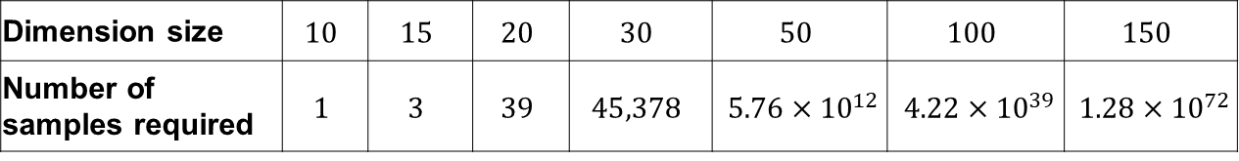
Curse of Dimensionality
Dimension Reduction for Big Data
25th June 2018
Data isolation
Number of training samples required for a K-Nearest Neighbour search algorithm
Dimension size | $$10$$ | $$15$$ | $$20$$ | $$30$$ | $$50$$ | $$100$$ | $$150$$
Number of samples required | $$1$$ | $$3$$ | $$39$$ | $$45,378$$ | $5.76×{10}^{12}$ | $4.22×{10}^{39}$ | $1.28×{10}^{72}$

Slide 6
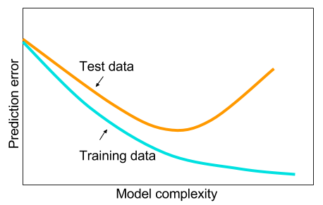
Curse of Dimensionality
Dimension Reduction for Big Data
25th June 2018
Data isolation
Overfitting
Notes:
The complexity of the data increases with the dimensionality.
In a neural networks application, the hidden layers will be very complex.
This leads to…..

Slide 7
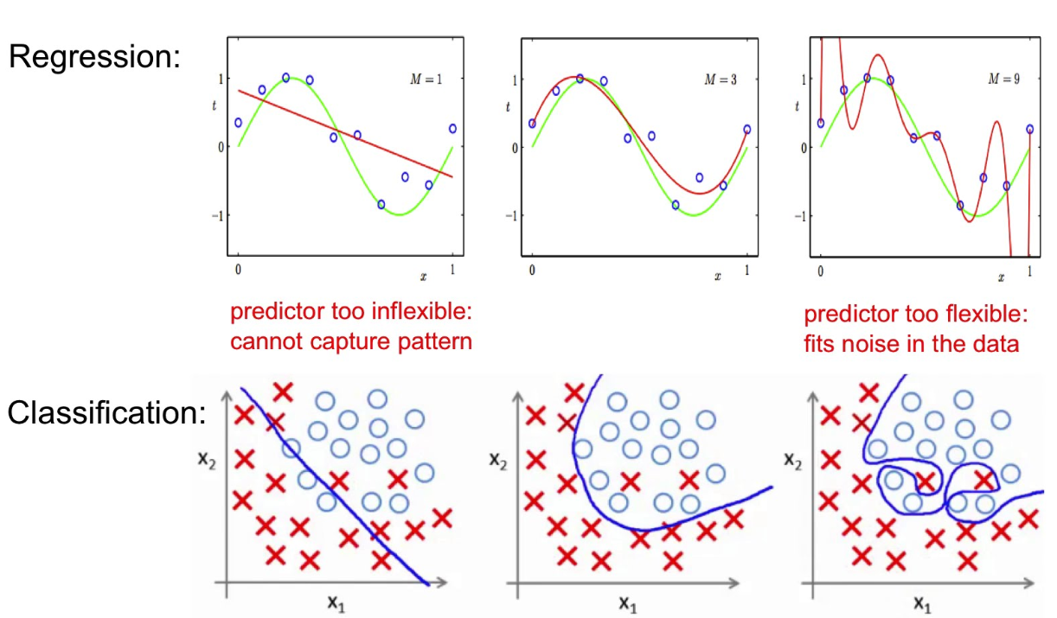
Curse of Dimensionality
Dimension Reduction for Big Data
25th June 2018
Data isolation
Overfitting
False Structure

Slide 8
Curse of Dimensionality
Dimension Reduction for Big Data
25th June 2018
Data isolation
Overfitting
False Structure
Computation difficulty
Time
Complexity
Notes:
A simpler, but sometimes very effective,
way of dealing with high-dimensional data is to reduce the number of dimensions

Slide 9
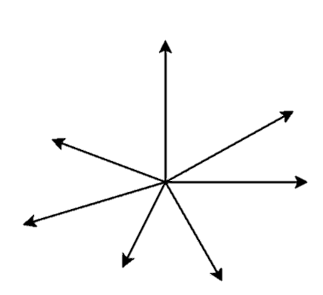
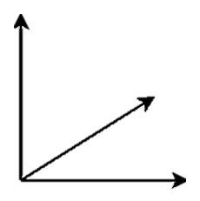



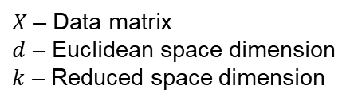


Random Projection (1)
Dimension Reduction for Big Data
25th June 2018
$$Φ$$
$$d>k$$
$X$ in $ℝ^{d}$
$Φ(X)$ in $ℝ^{k}$
Assist applications whose data is represented geometrically in high dimensional vector spaces
$X$ – Data matrix
$d$ – Euclidean space dimension
$k$ – Reduced space dimension

Slide 10
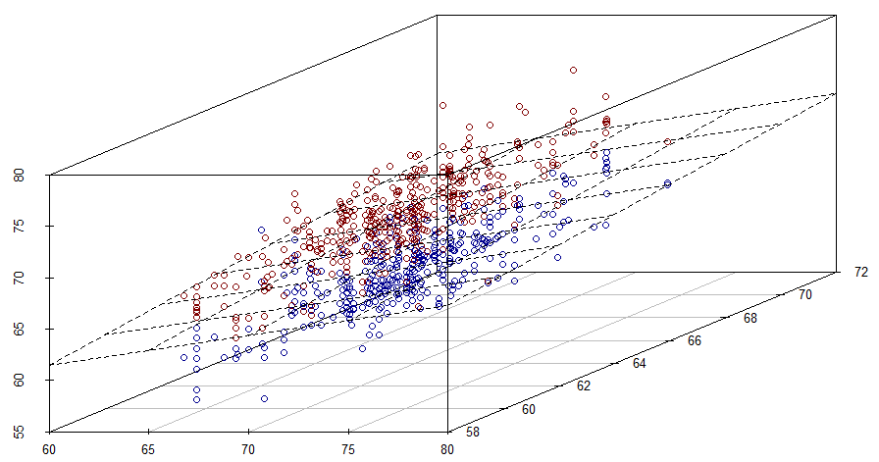
Random Projection (2)
Dimension Reduction for Big Data
25th June 2018

Slide 11
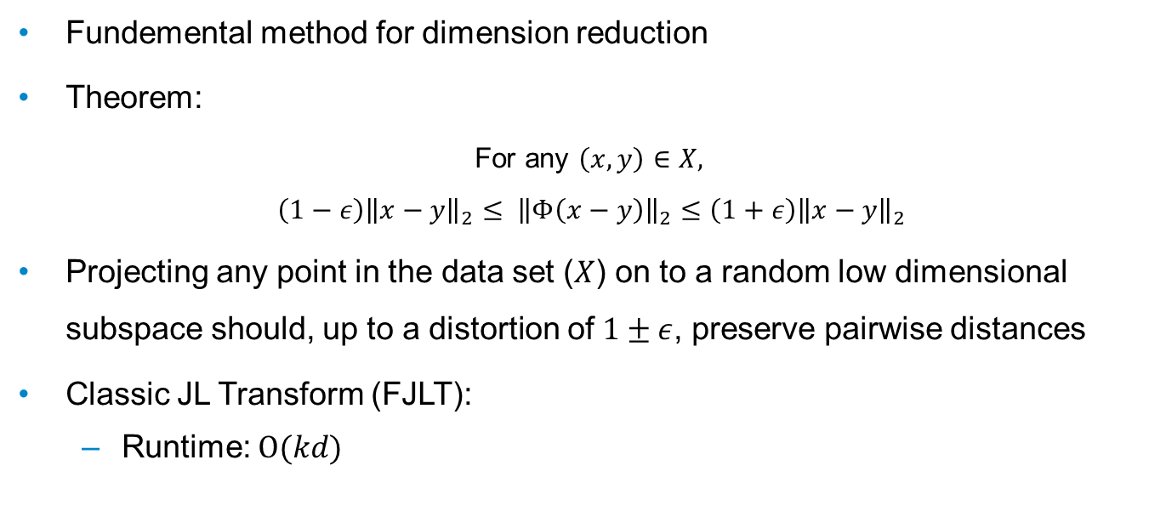
Johnson-Lindenstrauss Transform
Dimension Reduction for Big Data
25th June 2018
Fundemental method for dimension reduction
Theorem:
For any $\left(x,y\right)∈X,$
$$\left(1−ε\right){\left\|x−y\right\|}_{2}≤ {\left\|Φ\left(x−y\right)\right\|}_{2}≤\left(1+ε\right){\left\|x−y\right\|}_{2}$$
Projecting any point in the data set ($X$) on to a random low dimensional subspace should, up to a distortion of $1±ε$, preserve pairwise distances
Classic JL Transform (FJLT):
Runtime: $O(kd)$
k: reduced dimension; d: original dimension; n: sample size

Slide 12
Goal
Dimension Reduction for Big Data
25th June 2018
Implement structured random matrices to speed up the JL transform
Fast JL Transforms (FJLT)
Notes:
implement efficient random projectors for dimension reduction
yielding low-complexity solutions to dimension reduction

Slide 13
Design Methods
Dimension Reduction for Big Data
25th June 2018
FJLT projection method 1
Sparse matrices
FJLT projection method 2
Methods from coding theory

Slide 14

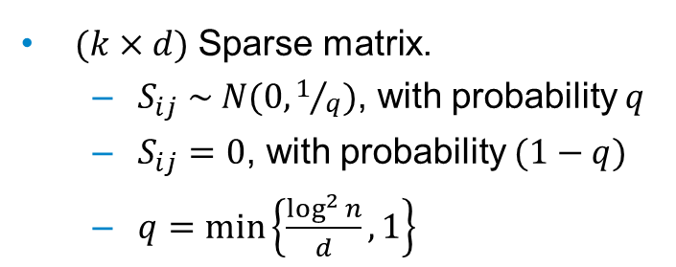
FJLT Method 1
Dimension Reduction for Big Data
25th June 2018
$$Φ=S . H . D$$
$(k×d)$ Sparse matrix.
$S_{ij} \sim N(0,1/q)$, with probability $q$
$S_{ij}=0$, with probability $(1−q)$
$q=\min\left\{\frac{\log^{2}{n}}{d},1\right\}$
k: reduced dimension; d: original dimension; n: sample size
Notes:
Dimension reduction matrix
Sparsifies the input vector
But if input vector is too sparse (i.e. only one non-zero element)

Slide 15
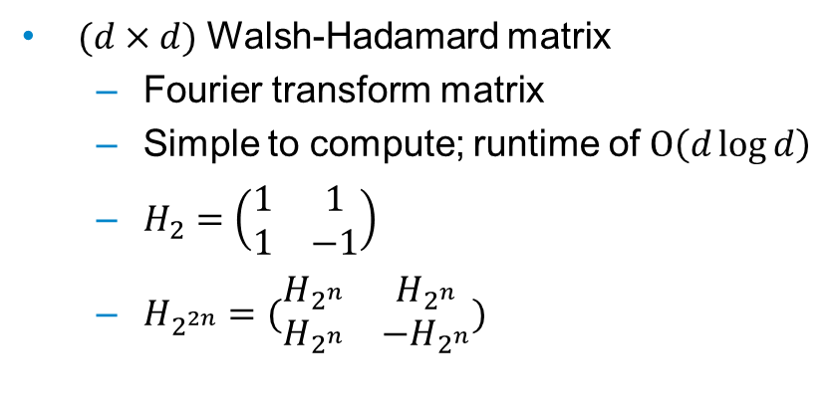
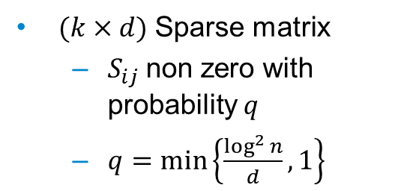
FJLT Method 1
Dimension Reduction for Big Data
25th June 2018
$$Φ=S . H . D$$
$(k×d)$ Sparse matrix
$S_{ij}$non zero with probability $q$
$q=\min\left\{\frac{\log^{2}{n}}{d},1\right\}$
$(d×d)$ Walsh-Hadamard matrix
Fourier transform matrix
Simple to compute; runtime of $Ο\left(d\log{d}\right)$
$H_{2}=\left(\begin{matrix}1 & 1 \\ 1 & −1\end{matrix}\right)$
$H_{2^{2n}}=(\begin{matrix}H_{2^{n}} & H_{2^{n}} \\ H_{2^{n}} & −H_{2^{n}}\end{matrix})$
k: reduced dimension; d: original dimension; n: sample size
Notes:
Densifies the input vector i.e any sparse vector

Slide 16
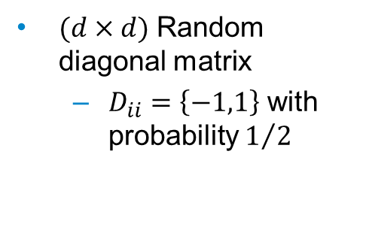
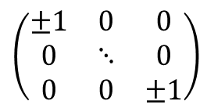
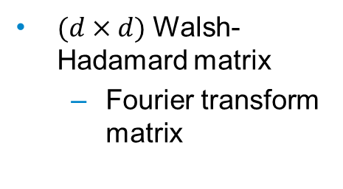
FJLT Method 1
Dimension Reduction for Big Data
25th June 2018
$$Φ=S . H . D$$
$(k×d)$ Sparse matrix
$S_{ij}$non zero with probability $q$
$q=\min\left\{\frac{\log^{2}{n}}{d},1\right\}$
$(d×d)$ Walsh-Hadamard matrix
Fourier transform matrix
$(d×d)$ Random diagonal matrix
$D_{ii}=\left\{−1,1\right\}$ with probability $1/2$
$$\left(\begin{matrix}±1 & 0 & 0 \\ 0 & ⋱ & 0 \\ 0 & 0 & ±1\end{matrix}\right)$$
k: reduced dimension; d: original dimension; n: sample size
Notes:
To make sure that dense vectors does not become sparse, a random matrix is introduced.

Slide 17
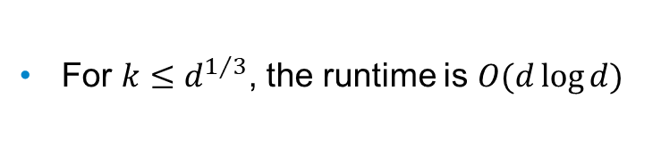
FJLT Method 1
Dimension Reduction for Big Data
25th June 2018
$$Φ=S . H . D$$
$(k×d)$ Sparse matrix
$S_{ij}$non zero with probability $q$
$q=\min\left\{\frac{\log^{2}{n}}{d},1\right\}$
$(d×d)$ Walsh-Hadamard matrix
Fourier transform matrix
$(d×d)$ Random diagonal matrix
$D_{ii}=\left\{−1,1\right\}$ with probability $1/2$
For $k≤d^{1/3}$, the runtime is $O(d\log{d})$
k: reduced dimension; d: original dimension; n: sample size
Notes:
To make sure that dense vectors does not become sparse, a random matrix is introduced.

Slide 18
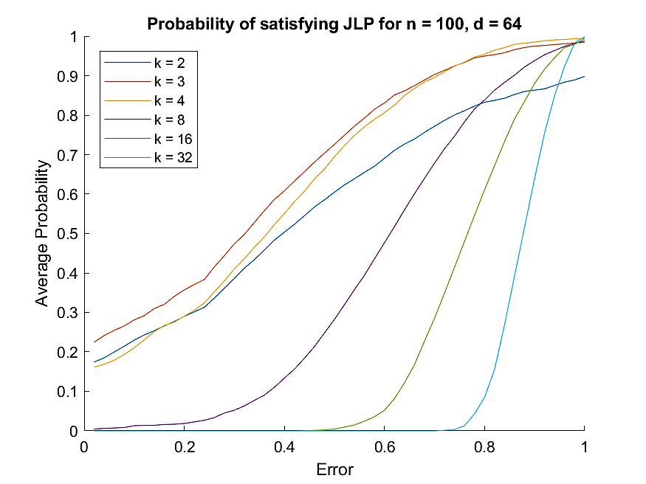
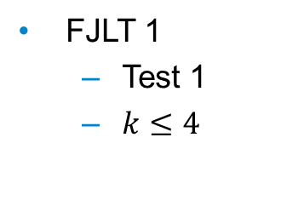
Results
Dimension Reduction for Big Data
25th June 2018
FJLT 1
Test 1
$k≤4$
k: reduced dimension; d: original dimension; n: sample size

Slide 19
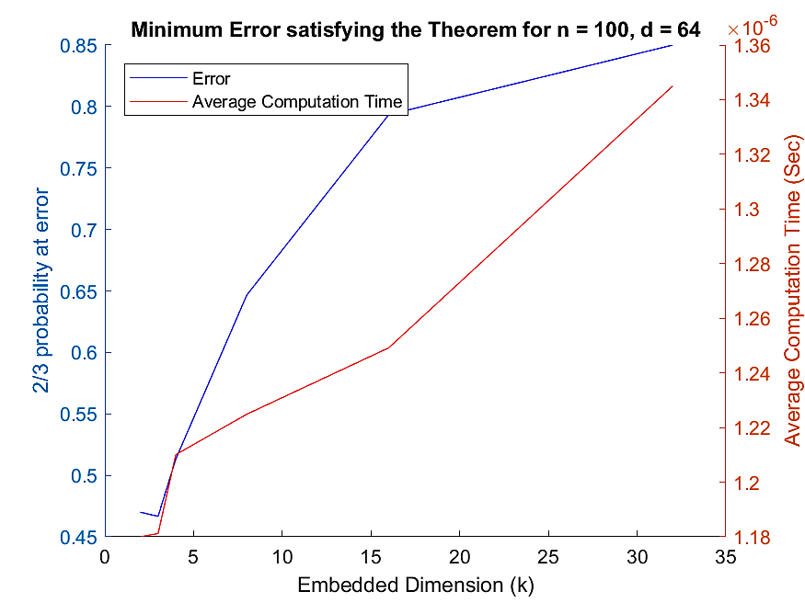
Results
Dimension Reduction for Big Data
25th June 2018
FJLT 1
Test 1
$k≤4$
k: reduced dimension; d: original dimension; n: sample size

Slide 20
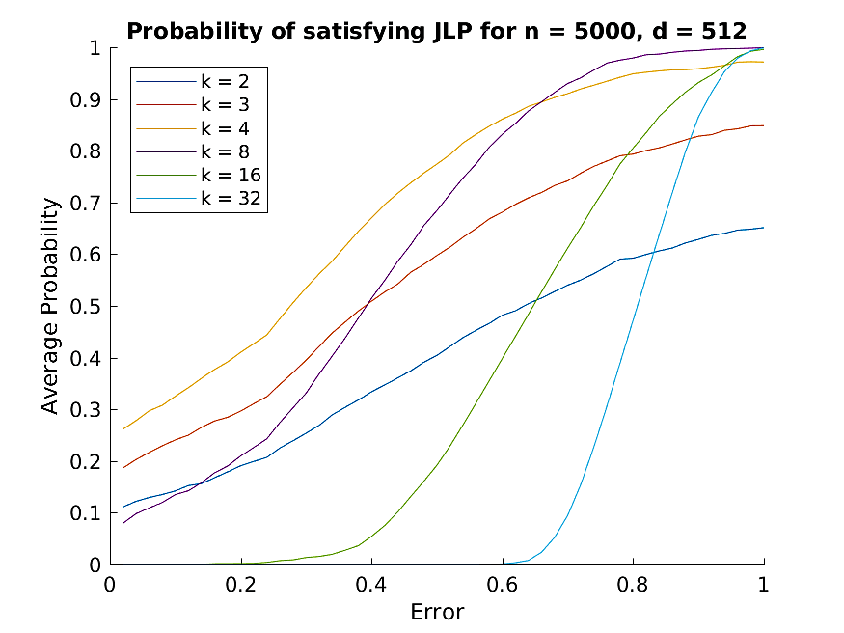
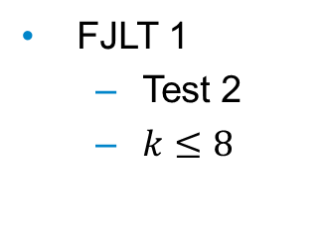
Results
Dimension Reduction for Big Data
25th June 2018
FJLT 1
Test 2
$k≤8$
k: reduced dimension; d: original dimension; n: sample size

Slide 21
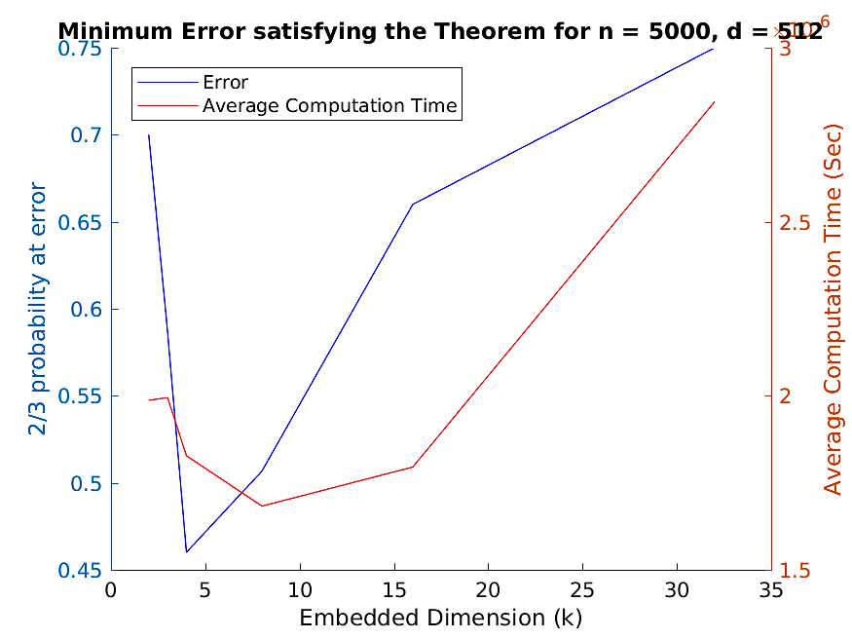
Results
Dimension Reduction for Big Data
25th June 2018
FJLT 1
Test 2
$k≤8$
k: reduced dimension; d: original dimension; n: sample size

Slide 22

Design Methods
Dimension Reduction for Big Data
25th June 2018
FJLT projection method 1
Sparse matrices
Computation time: $O(d\log{d})$
Reduced dimension: $k≤d^{1/3}$
FJLT projection method 2
Methods from coding theory
k: reduced dimension; d: original dimension; n: sample size
Notes:
yielding low-complexity solutions to dimension reduction
implement efficient random projectors for dimension reduction

Slide 23

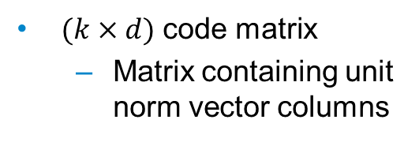


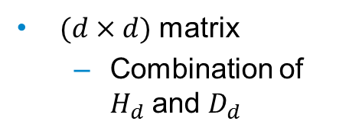

FJLT Method 2
Dimension Reduction for Big Data
25th June 2018
$$Α=B . D . Φ_{d}^{r}$$
$(k×d)$ code matrix
Matrix containing unit norm vector columns
$(d×d)$ Random diagonal matrix
$D_{ii}=\left\{−1,1\right\}$ with probability $1/2$
$(d×d)$ matrix
Combination of $H_{d}$ and $D_{d}$
For $k<d^{1/2}$, the runtime is $O(d\log{k})$
k: reduced dimension; d: original dimension; n: sample size; H: Hadamard matrix

Slide 24
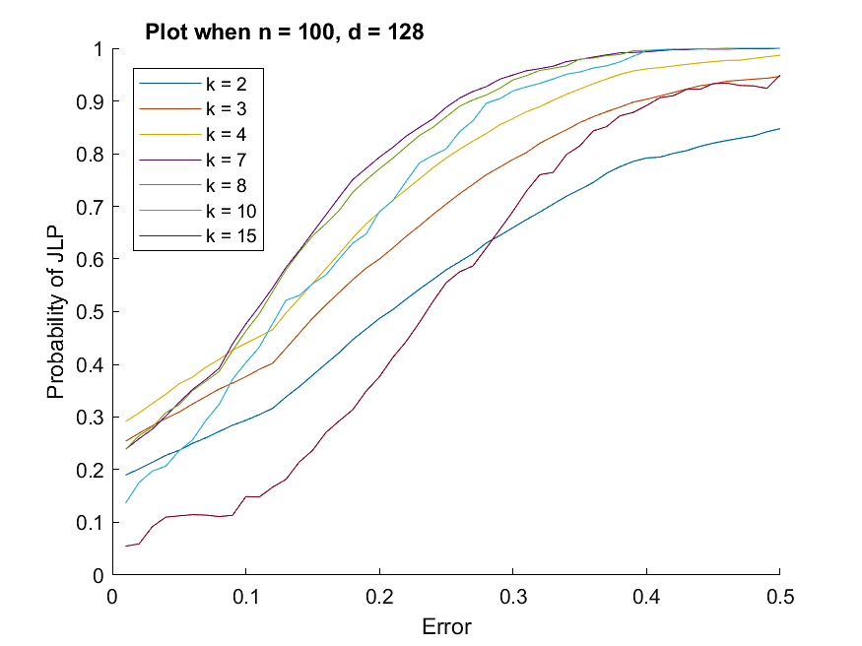
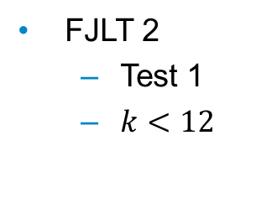
Results
Dimension Reduction for Big Data
25th June 2018
FJLT 2
Test 1
$k<12$
k: reduced dimension; d: original dimension; n: sample size

Slide 25
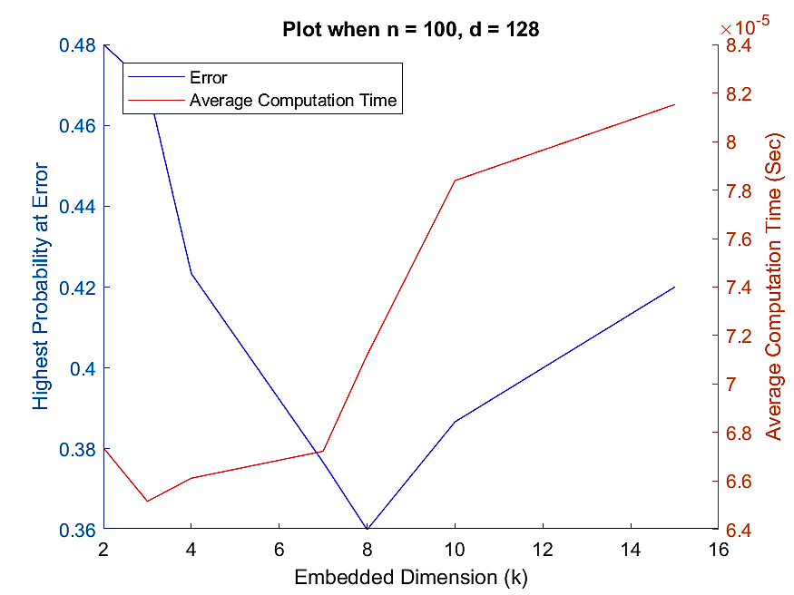
Results
Dimension Reduction for Big Data
25th June 2018
FJLT 2
Test 1
$k<12$
k: reduced dimension; d: original dimension; n: sample size

Slide 26
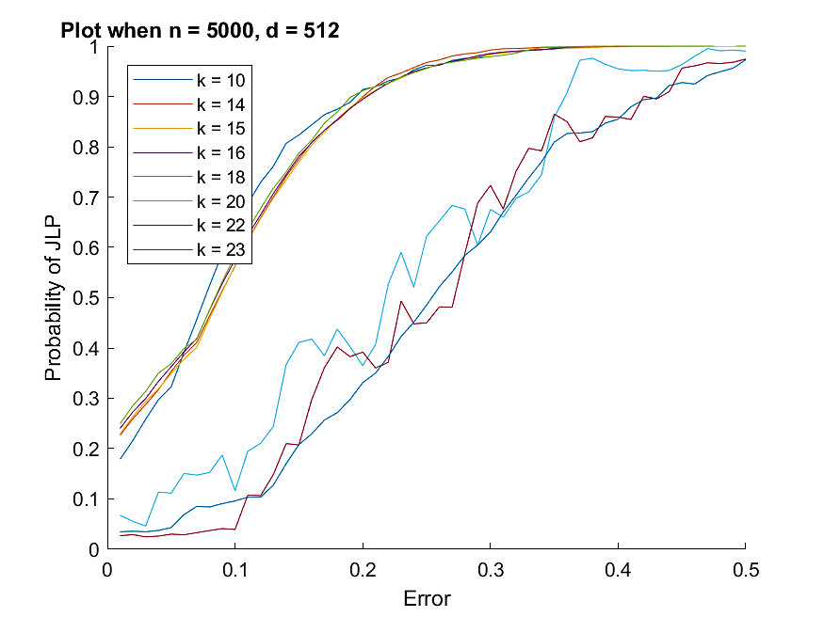

Results
Dimension Reduction for Big Data
25th June 2018
FJLT 2
Test 2
$k<23$
k: reduced dimension; d: original dimension; n: sample size

Slide 27
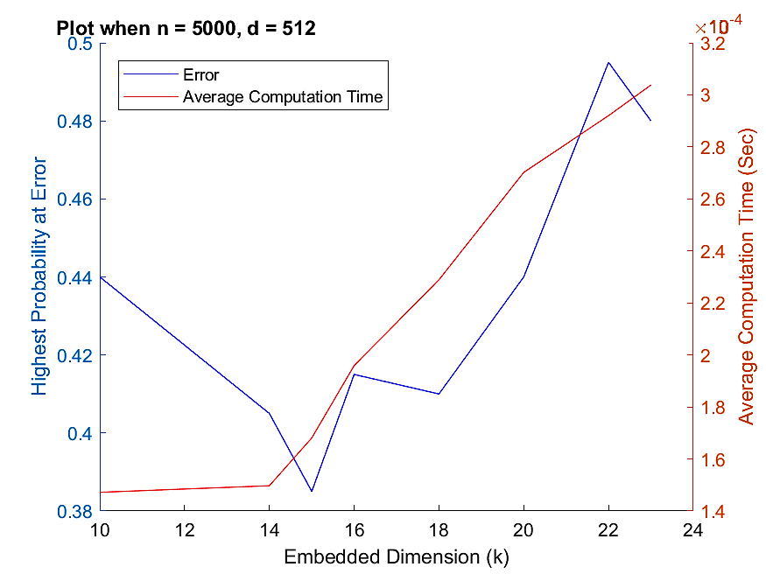
Results
Dimension Reduction for Big Data
25th June 2018
FJLT 2
Test 2
$k<23$
k: reduced dimension; d: original dimension; n: sample size

Slide 28

Summary
Dimension Reduction for Big Data
25th June 2018
FJLT projection method 1
Sparse matrices
Computation time: $O(d\log{d})$
Reduced dimension: $k≤d^{1/3}$
FJLT projection method 2
Methods from coding theory
Computation time: $O(d\log{k})$
Reduced dimension: $k<d^{1/2}$
k: reduced dimension; d: original dimension; n: sample size
Notes:
yielding low-complexity solutions to dimension reduction
implement efficient random projectors for dimension reduction

Slide 29
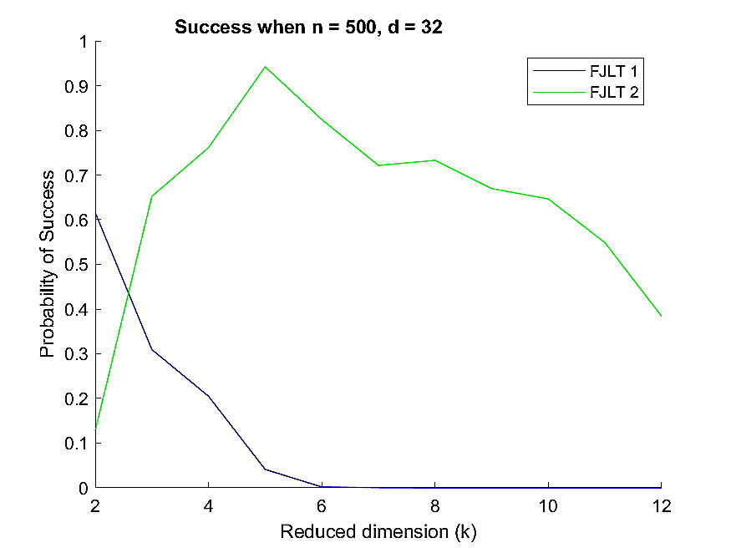
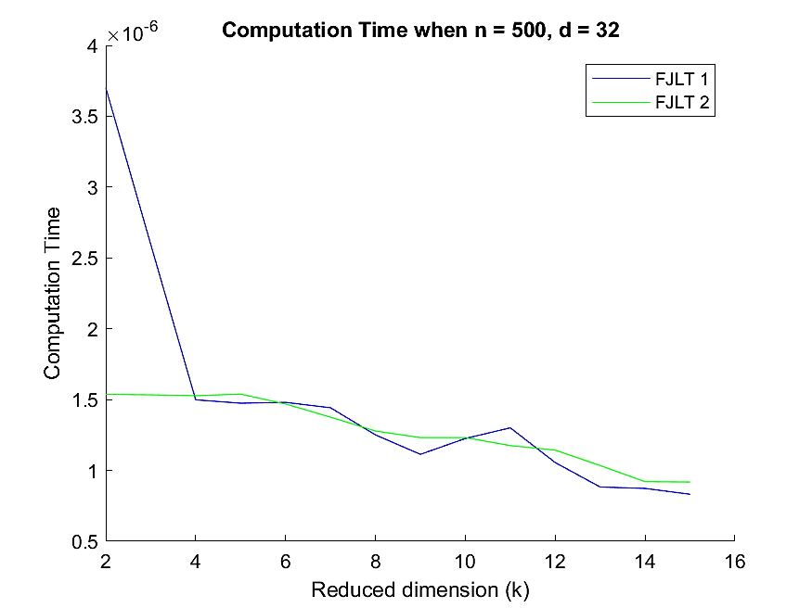
Comparison (1)
Dimension Reduction for Big Data
25th June 2018
k: reduced dimension; d: original dimension; n: sample size

Slide 30
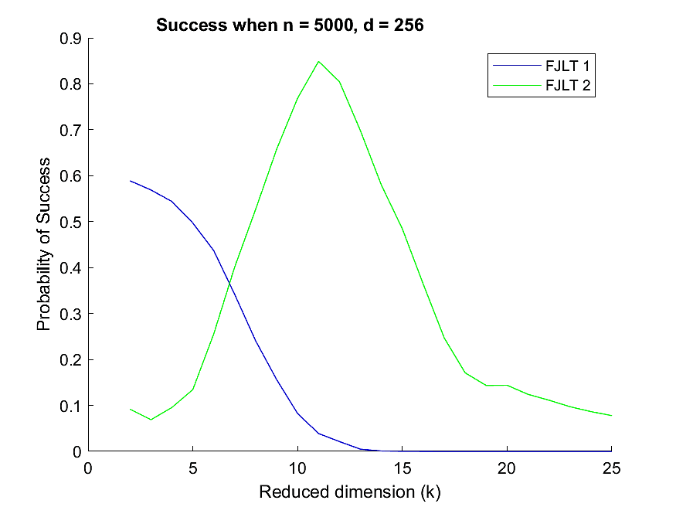
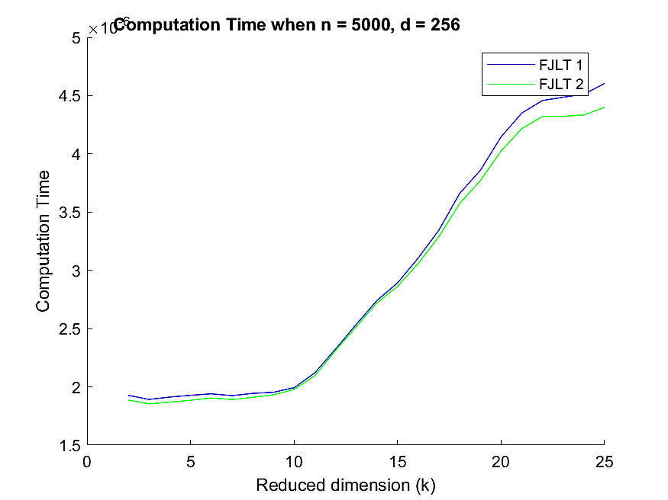
Comparison (2)
Dimension Reduction for Big Data
25th June 2018
k: reduced dimension; d: original dimension; n: sample size

Slide 31
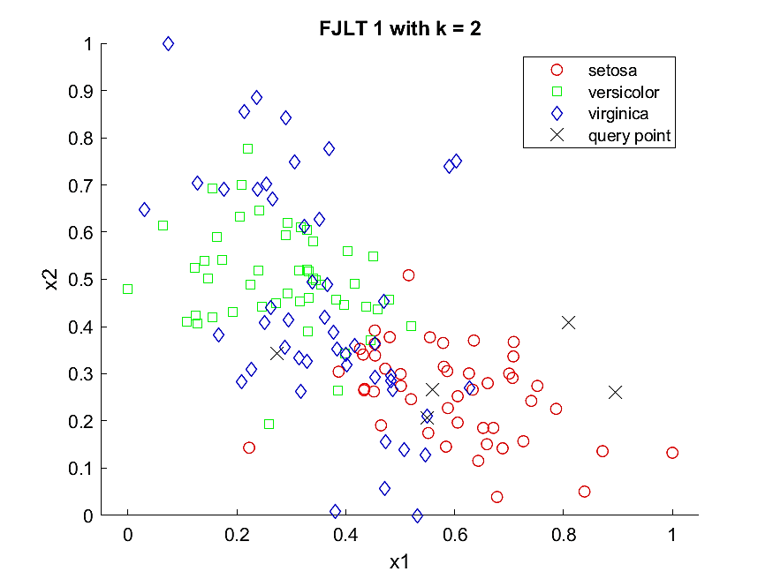
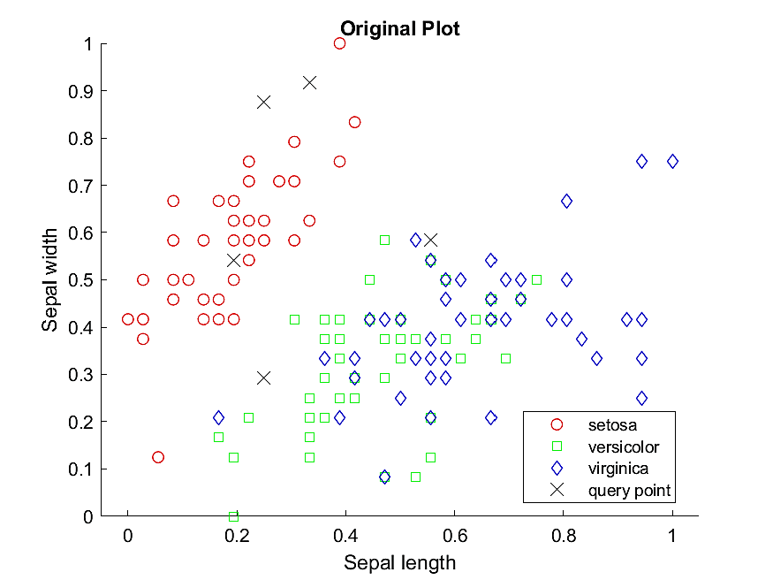
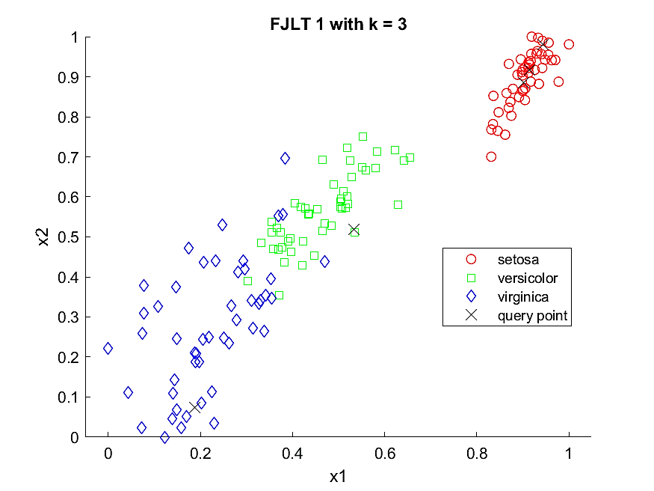
FJLT 1 on ML
Dimension Reduction for Big Data
25th June 2018
k: reduced dimension; d: original dimension;

Slide 32
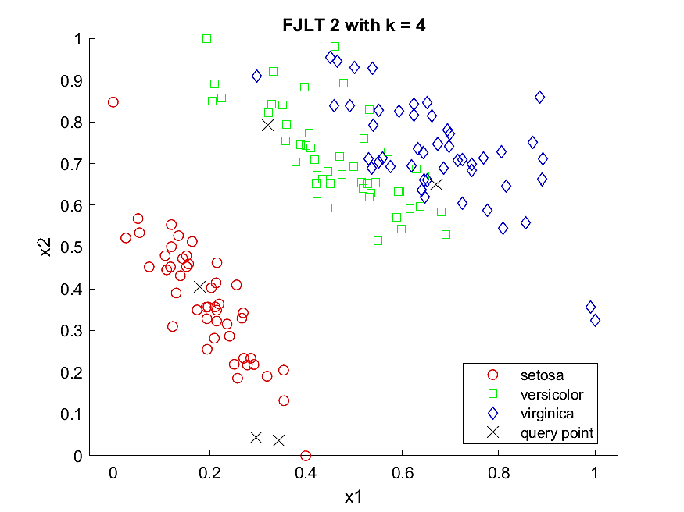
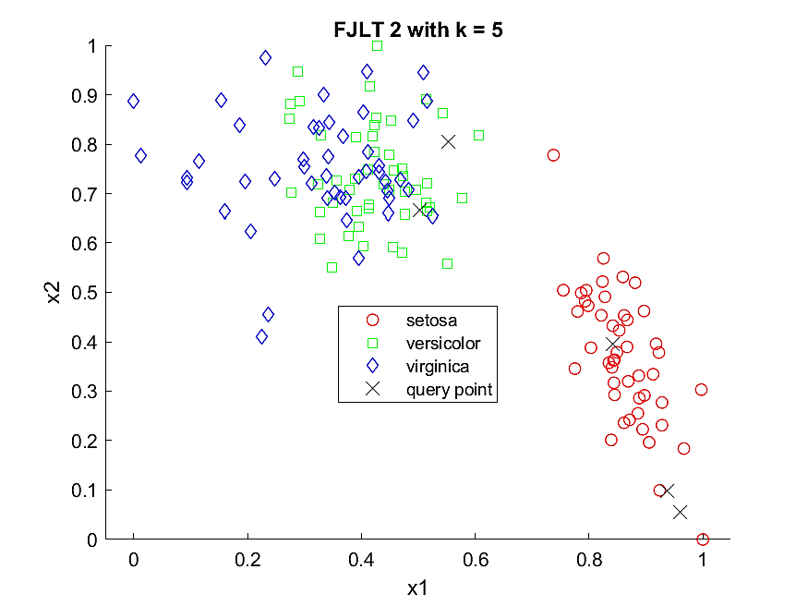
FJLT 2 on ML
Dimension Reduction for Big Data
25th June 2018
k: reduced dimension; d: original dimension;

Slide 33
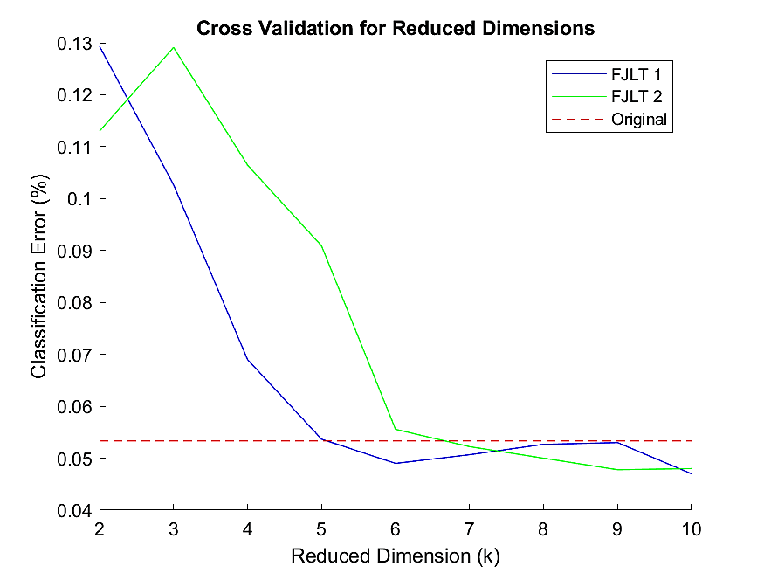
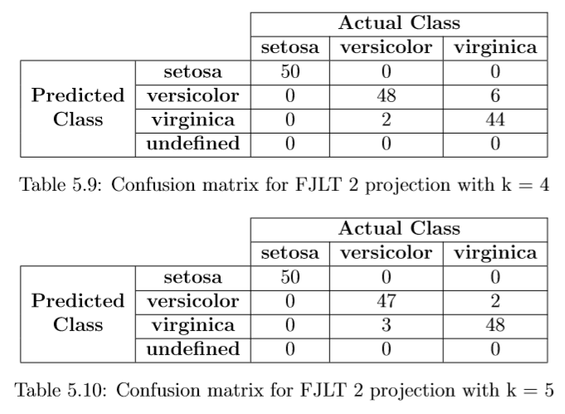
FJLT on ML
Dimension Reduction for Big Data
25th June 2018
Cross-validation test
k: reduced dimension; d: original dimension; n: sample size

Slide 34
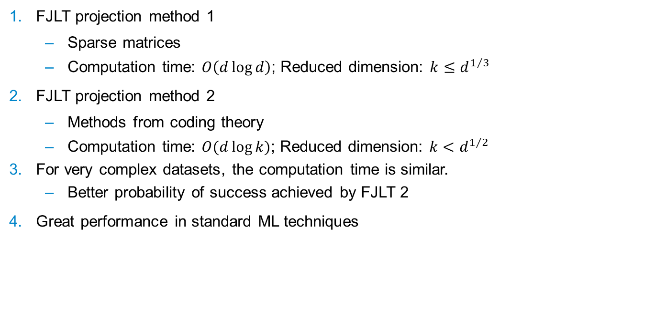
Conclusions
Dimension Reduction for Big Data
25th June 2018
FJLT projection method 1
Sparse matrices
Computation time: $O\left(d\log{d}\right)$; Reduced dimension: $k≤d^{1/3}$
FJLT projection method 2
Methods from coding theory
Computation time: $O(d\log{k})$; Reduced dimension: $k<d^{1/2}$
For very complex datasets, the computation time is similar.
Better probability of success achieved by FJLT 2
Great performance in standard ML techniques
k: reduced dimension; d: original dimension; n: sample size
Notes:
The two methods produces a reduced dimension solution with the lowest distortion.

Slide 35
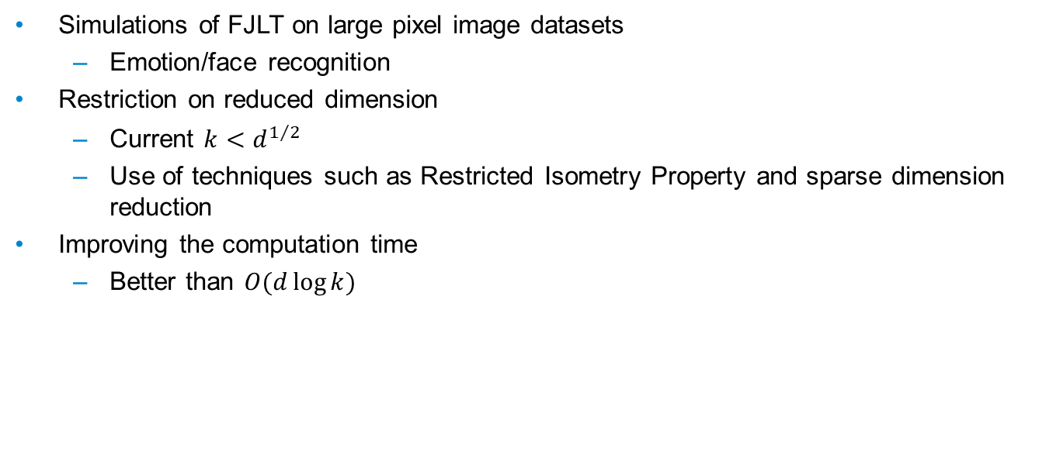
Future Work
Dimension Reduction for Big Data
25th June 2018
Simulations of FJLT on large pixel image datasets
Emotion/face recognition
Restriction on reduced dimension
Current $k<d^{1/2}$
Use of techniques such as Restricted Isometry Property and sparse dimension reduction
Improving the computation time
Better than $O(d\log{k})$
k: reduced dimension; d: original dimension; n: sample size

Slide 36
Thank you
25th June 2018
Devin Nanayakkara

Slide 37
APPENDIX
25th June 2018
Devin Nanayakkara

Slide 38
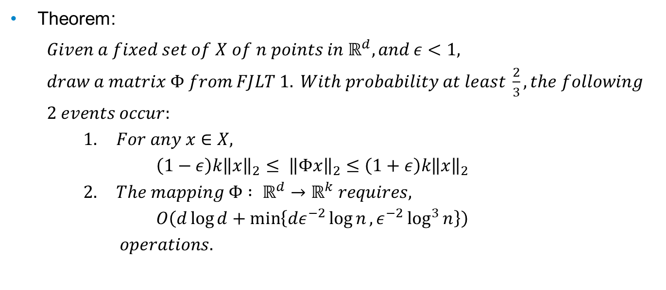
FJLT Method 1
Dimension Reduction for Big Data
25th June 2018
Theorem:
$Given a fixed set of X of n points in ℝ^{d}, and ε<1,$
$draw a matrix Φ from FJLT 1. With probability at least \frac{2}{3}, the following$
$2 events occur:$
$1. For any x∈X,$
$\left(1−ε\right)k{\left\|x\right\|}_{2}≤ {\left\|Φx\right\|}_{2}≤\left(1+ε\right)k{\left\|x\right\|}_{2}$
$2. The mapping Φ : ℝ^{d}→ℝ^{k} requires,$
$O\left(d\log{d+\min\left\{dε^{−2}\log{n},ε^{−2}\log^{3}{n}\right\}}\right)$
$operations.$
k: reduced dimension; d: original dimension; n: sample size

Slide 39
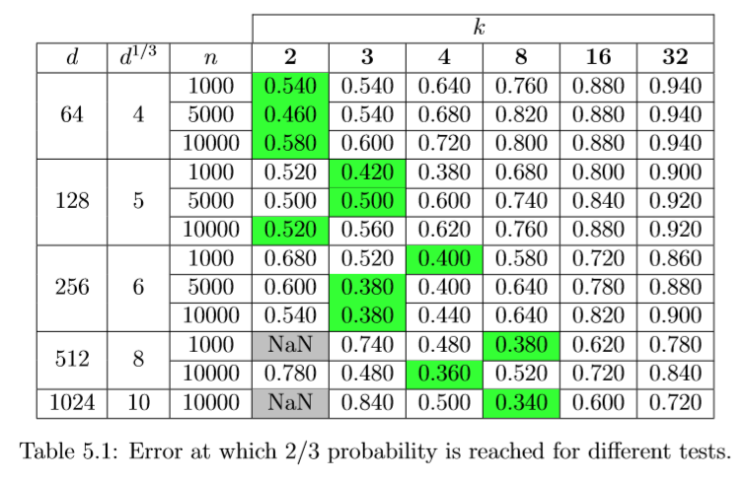
FJLT Method 1
Dimension Reduction for Big Data
25th June 2018
k: reduced dimension; d: original dimension; n: sample size

Slide 40
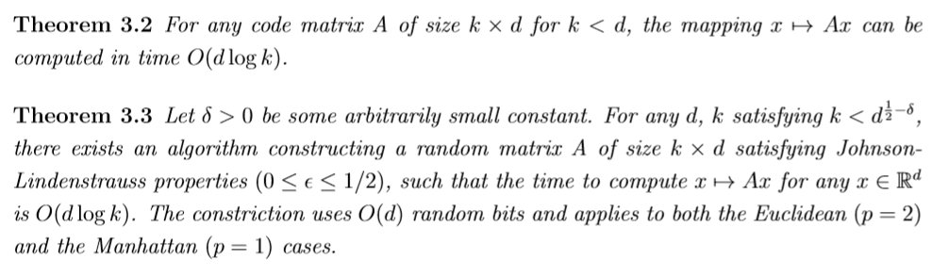
FJLT Method 2
Dimension Reduction for Big Data
25th June 2018
Theorems:
k: reduced dimension; d: original dimension; n: sample size

Slide 41

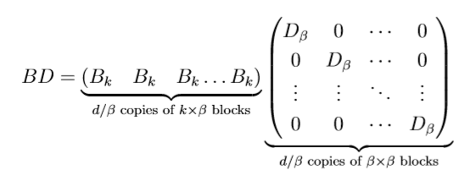

FJLT Method 2
Dimension Reduction for Big Data
25th June 2018
$$Α=B . D . Φ_{d}^{r}$$
k: reduced dimension; d: original dimension; n: sample size

Slide 42
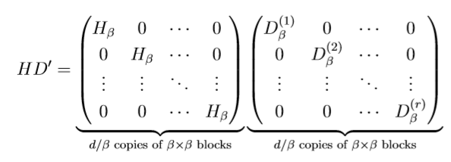
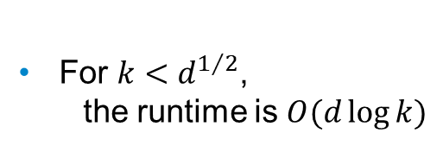

FJLT Method 2
Dimension Reduction for Big Data
25th June 2018
$$Α=B . D . Φ_{d}^{r}$$
For $k<d^{1/2}$,
the runtime is $O(d\log{k})$
k: reduced dimension; d: original dimension; n: sample size

Slide 43
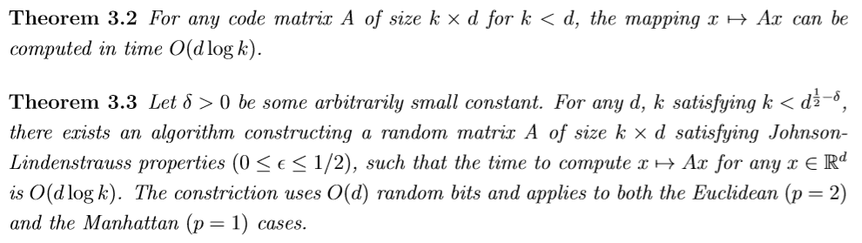
FJLT Method 2 (1)
Dimension Reduction for Big Data
25th June 2018
k: reduced dimension; d: original dimension; n: sample size

Slide 44



FJLT Method 2 (2)
Dimension Reduction for Big Data
25th June 2018
k: reduced dimension; d: original dimension; n: sample size

Slide 45

FJLT Method 2 (3)
Dimension Reduction for Big Data
25th June 2018
k: reduced dimension; d: original dimension; n: sample size

Slide 46

Comparison Tests
Dimension Reduction for Big Data
25th June 2018
k: reduced dimension; d: original dimension; n: sample size

Slide 47

FJLT on ML
Dimension Reduction for Big Data
25th June 2018
Summary of correctness tests
k: reduced dimension; d: original dimension; n: sample size

Slide 48

$l_{p}$-norm
Dimension Reduction for Big Data
25th June 2018

Slide 49

$$ℓ_{2} Regression$$
Appendix
25th June 2018
Least square fit of an overdetermined linear system
Old method:
Solution obtained by down sampling
Problem:
Complex solution
Down sampling distribution depends on norms of rows of the left singular vector matrix of the original system
Solution:
Multiply the equation matrix on the left by $HD$
The resulting left singular matrix have almost uniform sampling

Slide 50
Dimension Reduction for Big Data
25th June 2018

Slide 51
Dimension Reduction for Big Data
25th June 2018

